Slide 1

Azure Hub Notifications y Xamarin
Juan Carlos Zuluaga – “Zulu”
Twitter: @jzuluaga55
Email: jzuluaga55@hotmail.com
Notes:
This presentation provides an overview of why developers and businesses should want to build on the Microsoft platform. It is has been created to be used on its own or for you to use before you dive on more specific product or technical discussions.
Please send any feedback to platstory@Microsoft.com

Slide 2
From any back-end to all mobile platforms

Slide 3
Push to single users or millions at a time

Slide 4





Mobile push is everywhere
Breaking news
News/Media
SMS replacement, Deals, Back-office
Banking/Insurance
Prescriptions, Appointments,
LOB (maintenance)
Healthcare
Reservation changes, Deals, Back-office
Travel/Hospitality/Airlines
Orders, Product UX,
Back-office
Discrete manufacturing/Auto
Offers, Orders, Back-office
Retail

Slide 5
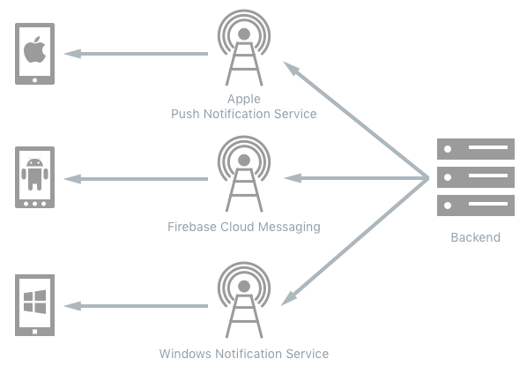
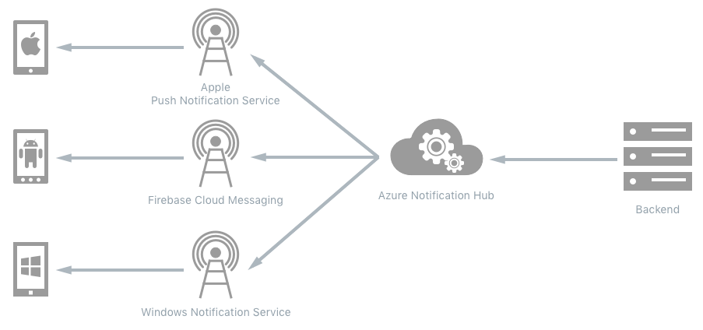
Traditional Vs. Azure

Slide 6
Push notification lifecycle
Registration at app launch
Client app contacts Platform Notification Service, to retrieve current channel (e.g. ChannelURIs, device tokens, registrationIds)
App updates handle in back-end
Sending Notification
App back-end send notification to PNS
PNS pushes the notification to the app on the device
Maintenance
Delete expired handles when PNS rejects them
Platform
Notification
Service
App back-end

Slide 7
Challenges of push notifications
Platform dependency
Different communication protocols to PNS’ (e.g. HTTP vs TCP, xml payload vs json payload)
Different presentation formats and capabilities (tiles vs toasts vs badges)
Routing
PNS’ provide a way to send a message to a device/channel
Usually notifications are targeted at users or interest groups (e.g. employees assigned to a customer account)
App back-end has to maintain a registry associating device handles to interest groups/users
Scale
App back-end has to store current handles for each device → high storage and VM costs
Broadcast to millions of devices with low latency requires parallelization (DB ad VM)

Slide 8
Using Notification Hubs
One-time set up
Create a Notification Hub
Register
The client app retrieves its current handle from the PNS
Client app creates (or updates) a registration on the Notification Hub with the current handle
Send Notification
The app back-end sends a message to the Notification Hub
Notification Hub pushes it to the PNS’
iOS app
Windows app
MPNS
GCM
WNS
APNs
App back-end
ADM
Notification Hub

Slide 9
Advantages of using Notification Hubs
X-plat: from any back-end to any mobile platform
Backend can be on-prem or in the cloud, .NET/Node/Java/PHP/Node/anything.
Support Windows Phone/Windows/iOS/Android and (as of today) Kindle Fire.
No need to store device information in the app back-end
Notification Hub maintains the registry of devices and the associations to users/interest groups
Routing and interest groups
Target individual users and large interest groups using tags
Personalization and localization
Keep your back-end free of presentation concerns like localization and user preferences using templates
Broadcast at scale, multicast, unicast
Push notifications to millions of devices (across platforms) with a single call
Telemetry
Rich telemetry available through portal or APIs

Slide 10


Case studies
Bing (news, finance, sports, …)
Sochi 2014
Preinstalled on windows
Millions of devices
Interest groups
(countries, disciplines, athletes)
Localized notifications
10s
100s
Millions of notifications/day
Minutes to delivery
Million devices
(iOS, Android, WP)
Million notifications
3+
<2
3+
150+

Slide 11
Demo: Get Started

Slide 12
!Muchas gracias!
Juan Carlos Zuluaga – “Zulu”
Twitter: @jzuluaga55
Email: jzuluaga55@hotmail.com

